Slide 1
Product Differentiation
UNIT- 8

Slide 2
BRAND POSITIONING

Slide 3
Product Positioning

Slide 4
What is Product Positioning
Product positioning is a form of marketing that presents the benefits of your product to a particular target audience. Through market research and focus groups, marketers can determine which audience to target based on favorable responses to the product.

Slide 5
Importance of Product Positioning
Product positioning is the process marketers use to determine how to best communicate their products' attributes to their target customers based on customer needs, competitive pressures, communication channels and carefully crafted key messages. Effective product positioning ensures that marketing messages resonate with target consumers and compel them to take action.

Slide 6
Steps In Product Positioning
1. Know your target audience well:
It is essential for the marketers to first identify the target audience and then understand their needs and preferences. Every individual has interests, needs and preferences. No two individuals can think on the same lines.

Slide 7
2. Identify the product features:
The marketers themselves must be well aware of the features and benefits of the products.
A marketer selling REDMI phones should himself also use a REDMI handset for the customers to believe him.

Slide 8
3. Unique selling Propositions :
Every product should have USPs; at least some features which are unique. The organizations must create USPs of their brands and effectively communicate the same to the target audience.
USP of a REDMI – Fast as Light.

Slide 9
4.Know your competitors
A marketer must be aware of the competitor’s offerings. Let the individuals know how your product is better than the competitors
Let the target audience know how your product is better than others.
The marketers must always strive hard to have an edge over their competitors.

Slide 10
5.Ways to promote brands
Choose the right theme for the advertisement.
Use catchy taglines.
The advertisement must not confuse people.
The marketer must highlight the benefits of the

Slide 11
6.Maintain the position of the brand
For an effective positioning it is essential for the marketers to continue to live up to the expectations of the end
- users.

Slide 12
Identifying Possible Competitive Advantages.
Product differentiation
Service differentiation
Channel differentiation
People differentiation
Image differentiation

Slide 13
Product Differentiation
Product differentiation is how a product or service stands out in the eyes of customers.
product differentiation brands can be differentiated on Features, performance, or style and design.
REDMI
I-PHONE

Slide 14
Service differentiation
◆ Where products are tangible in nature and easily differentiated on the basis of features, form, performance and quality, service differentiation

Slide 15
Channel differentiation
◆ Channel differentiation gain competitive advantage through the way they design their channels coverage, and performance.

Slide 16
People differentiation
People differentiation—hiring and training better people than their competitors do.

Slide 17
Image differentiation
◆ A company or brand image should convey the product’s distinctive benefits and positioning.

Slide 18
CASE STUDY

Slide 19
What…
Positioning is owning a piece of consumer’s mind
Positioning is not what you do to a product
It’s what you do to the mind of the prospect
You position the product in the prospect’s mind
‘It’s incorrect to call it Product Positioning’ – Ries & Trout

Slide 20
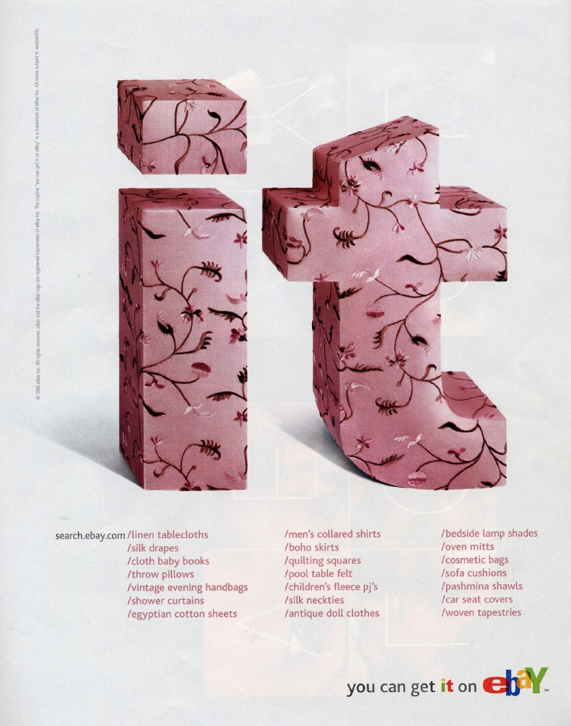
Positioning Example
eBay’s positioning: No matter what “it” is, you can find “it” on eBay!

Slide 21
Positioning Example
To (target segment and need) our (brand) is a (concept) that (point-of-difference).
“To busy mobile professionals who need to always be in the loop, Blackberry was a wireless connectivity solution that allowed you to stay connected to people and resources while on the go more easily and reliably than the competing technologies.”

Slide 22
Positioning Maps: Luxury SUVs Price vs. Orientation Dimensions

Slide 23
Positioning Strategy
Competitive advantages
Points of Parity
Points of Difference => Differentiation
Positioning results from differentiation and competitive advantages.
Positioning may change over time.

Slide 24
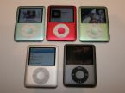
Sources of Differentiation
Product Design
Quality
Additional Services
Image
People (Staff)
Price
Other

Slide 25
Choosing the Right Competitive Advantages
The best competitive advantages are…
Important
Distinctive
Superior
Communicable
Affordable (to company and consumer)
Profitable
Moral: Avoid meaningless differentiation.

Slide 26
Point of parity of each brand
Points of Parity (POP) are usually the attributes or functionalities or benefits or any other marketing mix elements that are not unique to the brand and might be shared by some or all the competitors, as they mostly include the basic necessities for a brand to be considered in a particular category.
Two types of point of parity Category Points of Parity, Competitive Points of Parity to capture the market position.

Slide 27
Point of parity and point of difference of Lifebuoy
Points of parity of Lifebuoy are those associations or particular attribute of lifebuoy that can attract the customer easily, these attributes are:
Family soap
Ingredients
Quality
Innovation

Slide 28
Points of difference of Lifebuoy
PODs are attributes or benefits that consumers strongly associate with a brand, positively evaluate and believe that they could not find to the same extent with a competitive brand.
Points of difference of life buoy are those features or attribute of lifebuoy that the consumer can easily differentiate and positively evaluate this soap from its competitors. This attributes are:

Slide 29
Points of difference of Lifebuoy
History & Heritage.
Exclusive imagery.
Achievement.
Premium Price.

Slide 30
Point of parity Sandalina Sandal Soap
Family soap
Differentiation with competitors
Good imagery

Slide 31
Point of difference of Sandalina Sandal Soap
Vegetable fat
Sandal wood oil
Attractive packaging

Slide 32
In-class Activity
Describe how each of the following brands, companies, or products is positioned:

Slide 33
Coca Cola Competitive Advantage
Coca Cola is the largest beverage company of the world, and it provides consumers with more than five hundred different brands. Coca Cola is the most valuable company of the world and it includes as products Fanta, Coca Cola Zero, Powerade, and Minute Maid. At the moment the company focuses on the having sustainable community protecting environment and having good economical development.
As economic advance or develop the growing proportion of there activities get focus on production of services, for instant USA economy consist of seventy-thirty services to good mix. Services for instant include working in airlines, hotels, banks, doctors, and software programmers. Many market consist of both offering of service and goods for instant fast food company offer both service and goods.
Marketing promotion strategy
Coca Cola has most popular marketing promotion strategy because its brand is widely known. To make a successful marketing promotion strategy a company must analysis trends (internal and external), spending throughout company, identify customer and touch point for company and the brand and to have innovation in its promotions marketing. Coca Cola has been advertising on TV over fifty years. Coca Cola songs and commercials are extremely popular and they have catchy mottos such as "Adds a refreshing relish to every form of exercise".

Slide 34
The end
Thank you

